Slide 1

Technical case study
Patient satisfaction survey data analysis and suggestions for the healthcare leadership
Yujin Kim, MSc. Business Analytics – Class 2023, UCSD
Notes:
Hi, My name is Yujin Kim, I am a data analyst with professional experience at LG, and studying business analytics at UCSD. Thank you for joining my technical case study presentation for Vanguard Data Analyst opportunity.

Slide 2
Executive Summary
Results directly impact the hospital’s finance and a healthcare organization’s reputation because they are publicly reported on the internet for all to see, and patients’ word-of-mouth plays a key role in attracting more customers to the organization.
Background - U.S. Hospital Customer Satisfaction survey
Our Mission
In order to keep the hospital financially strong with a high reputation,
encouraging word-of-mouth ‘Recommendation Intention’ indicator is imperative.
The Problem - Analysis Purpose
The unexplained relationship between ‘Recommendation Intention’ and other indicators.
We must uncover the relationship to identify key indicators for boosting word of mouth.
The Solution - Recommendation
Focus on improving a specific area of scores would efficiently drive a higher ‘Recommendation Intention’.
→ ‘Preference Acceptance’, ‘Patients’ understanding of healthcare responsibilities’
Notes:
To begin with, I’d like to give a summary of my presentation. For the background information, we have an NYC hospital patient satisfaction scores, which is a part of HCAPHS survey result.
From my market research, this survey results have a direct impact on the hospital’s finance because the government offers financial incentives based on the survey performance.
And the survey results are publicly reported on the internet for all to see; therefore results directly impact a healthcare organization’s reputation as well.
So our mission for strong hospital finance, we should acquire excellent survey performance. Since multiple indicators’ scores are converted into one single indicator which is Overall rating,
It is imperative to find an effective way to enhance the overall rating.
However, here’s our problem. We have yet to identify the relationship between rating and other indicators. Therefore, we don’t know which area we should tackle for the best outcomes.
And Finally, here’s the recommendation. If we focus our limited asset on enhancing the satisfaction score of ‘communication about medicines’ , it will efficiently drive a higher overall rating.

Slide 3
4
Data Overview
Next Steps
1
Contents
3
Recommendations
2
Analysis &
Findings
Simple linear regression analysis
Linear regression model
Correlation analysis
Chinese medicine
Kampo medicine
Ayurvedic medicine
Mercury is the closest planet and the smallest planet of them all
Venus has a beautiful name, but also very high temperatures
Despite being red, Mars is actually a cold place. It’s full of iron oxide dust
Notes:
In this presentation, I’ll first go over the data overview, then we’ll look into the analysis & findings, then recommendations and next steps will be discussed.

Slide 4
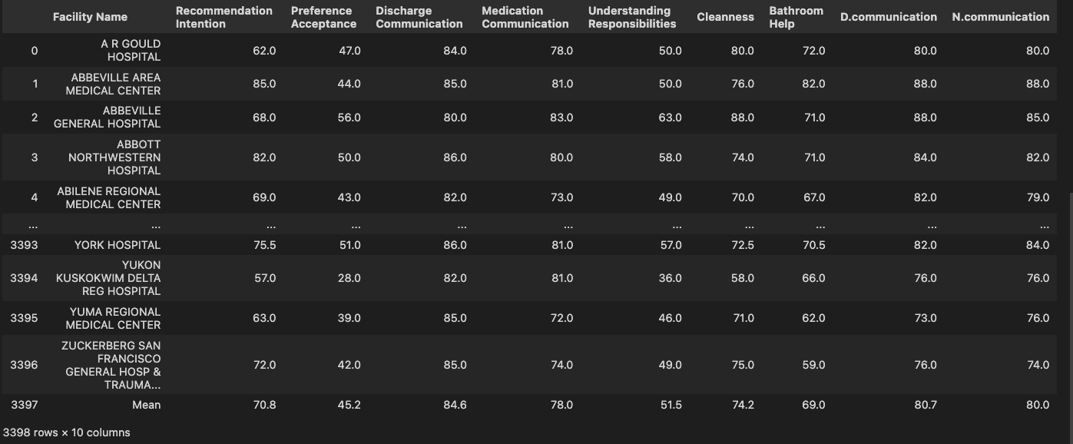
01. Data Set: Patient Satisfaction Survey
3397 healthcare organizations’ survey results with 9 indicators
Consisted of a series of questions that evaluate key elements of the patient experience.
CMS releases this quality data publicly in order to encourage hospitals to improve their quality and to help consumers make better decisions about which providers they visit.
Notes:
This survey data set evaluates patient satisfaction through quantitative measurements across multiple areas, including recommendation intention, communication about medicines and communication with doctors and nurses, etc.
Then Scores are calculated into a single, overall satisfaction rating. And This is the table that shows the entire data set with the Mean calculation at the bottom row.

Slide 5
01. Data Set: Overview
Mean of ‘Recommendation Intention’: 71
The Problem: How to effectively improve ‘Recommendation Intention’? Which indicators should we focus on?
Notes:
For a better understanding of the mean scores, we can see the bar chart here. The overall rating’s mean score is 54. and we can see that in orange color bars, the two strongest areas are Communication with doctors(76.7) and communication about recovery(78.5) whereas in blue color bars, Room Quietness(49.6), and Responsible service from staff(49.5) are the lowest.
Here, I’d like to ask a question. In order to boost the overall rating score, which area should we focus? Should we put more effort into the weakest indicators or the strongest?
Maybe other indicators play a more significant role than others.

Slide 6
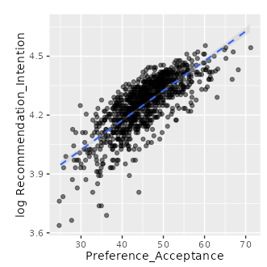
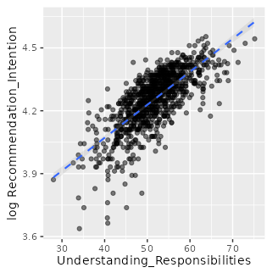
02. Analysis & Findings
1) Linear Relationships between Rating and other variables
Positive linear relationship: As one gets a higher score, the other gets a higher score as well
1
Strong Positive
2
Strong Positive
Strong positive relationships with ‘Recommendation Intention’:
‘Preference Acceptance’, ‘Patients’ understanding of healthcare responsibilities’
Notes:
To uncover the relationship between rating and other variables, I conducted a simple linear regression analysis, and it revealed quite interesting outcomes.
So the positive linear relationships between two variables mean that as one gets a higher score, the other gets a higher score as well.
The two strong positive relationships with the rating are observed in communication about Medicines and Recommendation Intention. On the other hand, communication with doctors shows almost 0 scope which means it rarely impacts on rating.

Slide 7
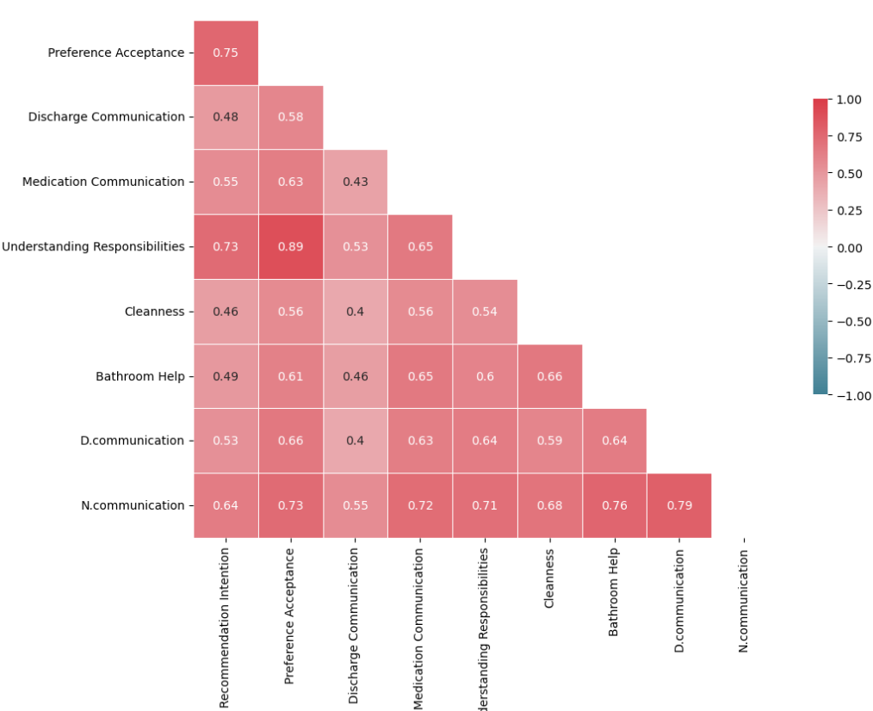
02. Analysis & Findings
2) Correlation between Rating and other variables
Correlation matrix analysis
Highest positive correlation with ‘Recommendation Intention’:
1) ‘Preference Acceptance’ (0.75)
2) ‘Patients’ understanding of healthcare
responsibilities’ (0.73)
It quantifies the degree to which two variables are
related and shows the direction and strength of the
association between two numeric variables.
Notes:
Now we move on to see the result of correlation analysis. Correlation quantifies the degree to which two variables are related with the direction and strength.
So the correlation score ranges from -1 to 1, and if the score is more toward 1, that shows a strong positive correlation.
And with this correlation matrix for a rating in the green box, we can see the highest positive correlation from ‘communication about medicines’ and ‘recommendation intention’ with the rating.

Slide 8
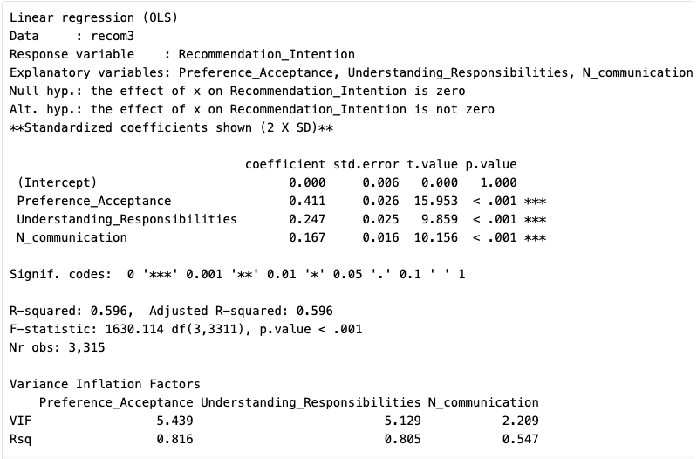
02. Analysis & Findings
3) Linear regression model: Hypothesis test
Strong positive coefficients & p.value of <.001 indicate to accept the alternative hypothesis
Combination of three indicators below would perform to boost the ‘Recommendation Intention’
Notes:
To uncover the relationship between rating and other variables, I conducted a simple linear regression analysis, and it revealed quite interesting outcomes.
So the positive linear relationships between two variables mean that as one gets a higher score, the other gets a higher score as well.
The two strong positive relationships with the rating are observed in communication about Medicines and Recommendation Intention. On the other hand, communication with doctors shows almost 0 scope which means it rarely impacts on rating.

Slide 9
03. Recommendations
The best usage of limited assets to effectively raise the ‘Recommendation Intention’
‘Preference Acceptance’
‘Patients’ understanding of healthcare responsibilities’
The Solution: Above the two ultimate key indicators to focus on for the best result.
Notes:
Here, the recommendations for the best usage of limited assets to effectively boost the overall rating could be ‘recommendation intention’ and ‘communication about medicines
However, with the business sense, the ‘recommendation intention’ indicator sounds less intuitive to build an action plan than the ‘communication about medicines’ indicator.
Moreover, from the nature of ‘recommendation intention’, there’s a higher chance that this indicator would fall into the causation problems than the other.
If we can gather more data to analyze than the 10 rows of data set, we could build a robust model to predict the relationship but for now, the realistic solution would be focusing on ‘communication about medicines’.

Slide 10
04. Next Steps
Actionable frameworks for the solution indicators:
‘Preference Acceptance’, ‘Patients’ understanding of healthcare responsibilities’
Personal Care
Use the patient’s name, ask questions involving the patient in their care, and deliver the customized service.
Non-medical Language
Empower patients to take charge of their health by offering detailed healthcare information with understandable words.
Establish a sense of trust
Taking a few minutes to engage with a patient before explaining medicines would help
establish trust between patients and staff.
Areas for further consideration : Caring for caretakers, Upgrading outdated systems, Cafeteria
Notes:
Moving forward, Here are actionable frameworks to enhancing communication about medicines for hospital staff.
Non-medical language: No patient wants to be left in the dark regarding their health. And using non-medical language could empower patients to take charge of their health and satisfaction.
Making care personal - Healthcare providers could use the patient’s name, asking questions that involve the patient in their own care, and make eye contact instead of looking at a computer screen.
Establish a sense of trust: Taking a few minutes to engage with a patient before beginning to explain about medicines would help establish trust between patients and staff. The more relaxed a patient is, the better satisfied they are with the service.
Additionally, there are
[Possible areas for improvement or gathering more information], such as Caring for the caretakers, Upgrading outdated systems, and Cafeteria food quality, etc

Slide 11
Thank you!

